Slide 1



Tutorial: Understanding Performance Interference Benchmarking and Application Profiling Techniques for Cloud-hosted Latency-Sensitive Applications
Shashank Shekhar, Yogesh Barve & Aniruddha Gokhale
shashank.shekhar@Vanderbilt.edu, Yogesh.d.barve@Vanderbilt.edu, a.gokhale@Vanderbilt.edu
Institute for Software Integrated Systems,
Dept. of Electrical Engineering and Computer Science
Vanderbilt University, Nashville, TN, USA

Slide 2
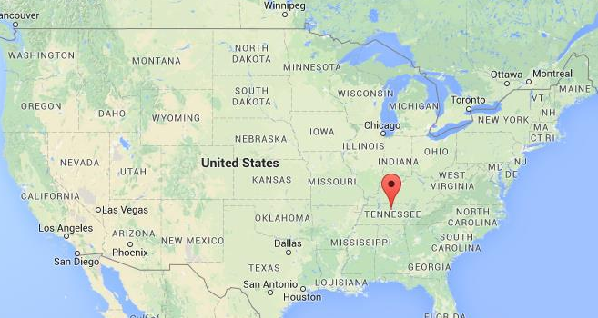
Vanderbilt Univ, Nashville, Tennessee

Slide 3


Nashville City & Vanderbilt University
Nashville facts
Capital city of TN
Music city, USA
Athens of the south
Several recording studios
Healthcare and healthcare IT
Banks of Cumberland river
City pop: 660,388; Metro area pop: 1,830,345
Vanderbilt University facts
Private university
Undergraduates: 6,871
Graduate students: 5,716
Total faculty: 4,315
Total staff: 4,195
Connected to Medical center
Ranked top 14 for undergraduate education

Slide 4
Outline
Motivation
Performance Interference Description
FECBench
Case studies
Break
Hands On
Conclusion & Open Discussion
Notes:
Latency – short messages, throughput – large flows

Slide 5
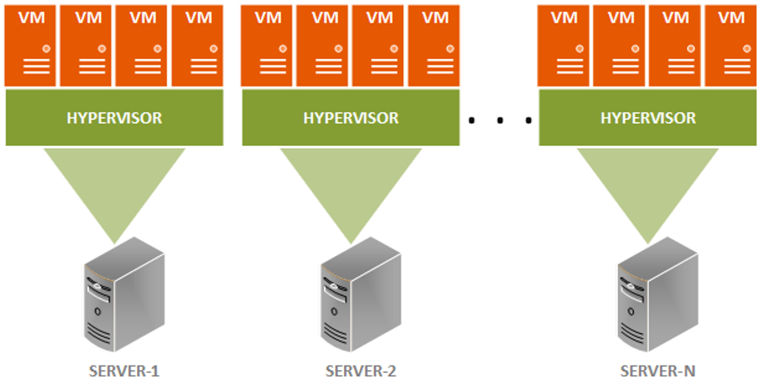
Motivation: Application Hosting in Cloud Data Centers
Virtualized Multi-tenant Servers

Slide 6
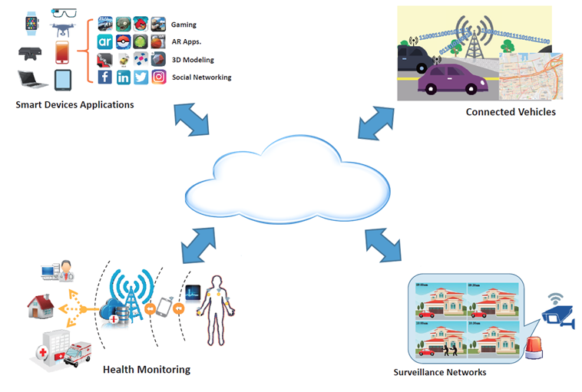
Motivation: Increasing Prevalence of Cloud-hosted Performance-sensitive Applications
Soft real-time Cyber-Physical Systems (CPS) and Internet of Things (IoT) applications, such as cognitive assistance, patient health monitoring, and connected vehicles are increasingly using the cloud
Elasticity
Cost benefits
The applications have stringent Quality of Service (QoS) needs
Cloud must provide:
predictable performance
lower end-to-end response time
Cloud providers wants to maximize their profit by lowering the cost of deployment

Slide 7
Performance Metrics of Importance
The following metrics are important for performance-sensitive cloud hosted applications
Response Time (Latency)
How long it takes to do a task
Throughput
Total work done per unit time
e.g., tasks/transactions/… per hour
Energy/Power
Measure of work being performed
Increases with clock frequency/voltage
Notes:
Latency – short messages, throughput – large flows

Slide 8
Cycles Per Instruction (CPI): A Measure of Program Execution time
Number of instruction classes
~= Instruction_count * CPI_{avg} * clock_cycle_time

Slide 9
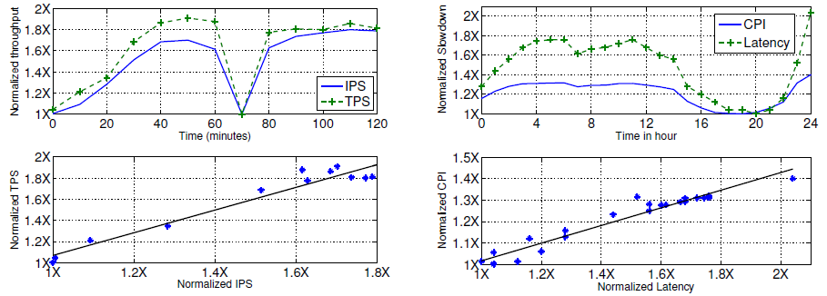
CPI: Can it Accurately Pinpoint Performance Issues?
Batch Job
Web Search (Latency Sensitive)
Fig Source: Zhang, Xiao, Eric Tune, Robert Hagmann, Rohit Jnagal, Vrigo Gokhale, and John Wilkes. "CPI 2: CPU performance isolation for shared compute clusters." In Proceedings of the 8th ACM European Conference on Computer Systems, pp. 379-391. ACM, 2013.

Slide 10
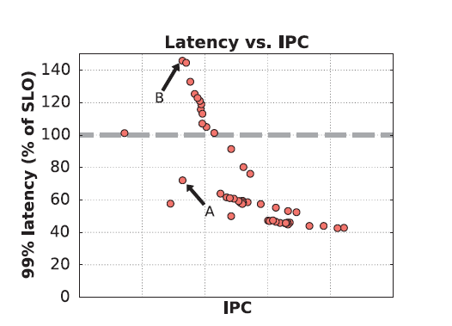
Important Artifact Missed by CPI: Tail Latency
Fig Source: Lo, David, Liqun Cheng, Rama Govindaraju, Parthasarathy Ranganathan, and Christos Kozyrakis. "Heracles: improving resource efficiency at scale." In ACM SIGARCH Computer Architecture News, vol. 43, no. 3, pp. 450-462. ACM, 2015.

Slide 11
CPI as a Performance Measure: Summary
CPI is a measure of throughput
CPI does not correlate well with tail latency
CPI does not measure network nor disk interference effects.

Slide 12
Causes of Performance Degradation in Cloud Data Center
Resource Overbooking
Performance Interference
Notes:
Latency – short messages, throughput – large flows

Slide 13
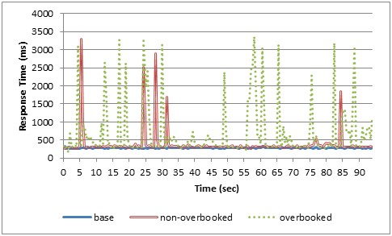
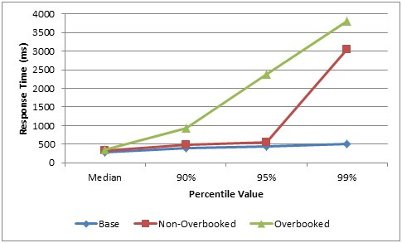
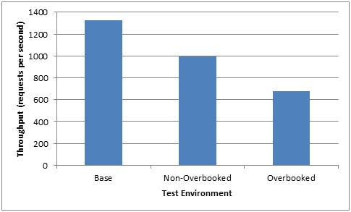
Common Cloud Provider Practices: Server Overbooking
Cloud service providers (CSPs) commit more resources than available
reduces power consumption by consolidating VMs
Serves more customers
May result in significant jitters
Bad for CPS/IoT applications
Figure Source: Faruk Caglar, Shashank Shekhar, Aniruddha Gokhale and Xenofon Koutsoukos. Intelligent, Performance Interference-Aware Resource Management for IoT Cloud Backends. In 2016 IEEE First International Conference on Internet-of-Things Design and Implementation (IoTDI), Berlin, Germany, 2016, pp. 95-105. doi: 10.1109/IoTDI.2015.36

Slide 14
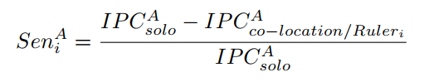
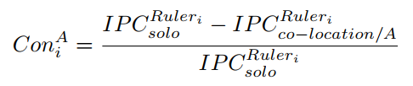
Performance Interference: Accounting for both Sensitivity and Pressure
Sensitivity: Performance degradation of an application due to interference from other applications
Pressure: Performance degradation of other co-located applications on the host due to the application
Depends both on the nature of application and the system architecture
Defined in: Zhang, Yunqi, Michael A. Laurenzano, Jason Mars, and Lingjia Tang. "Smite: Precise qos prediction on real-system smt processors to improve utilization in warehouse scale computers." In Proceedings of the 47th Annual IEEE/ACM International Symposium on Microarchitecture, pp. 406-418. IEEE Computer Society, 2014.

Slide 15
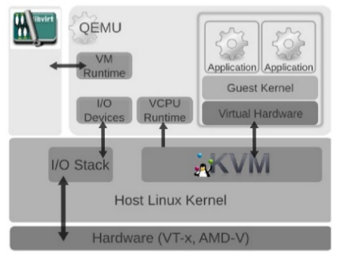
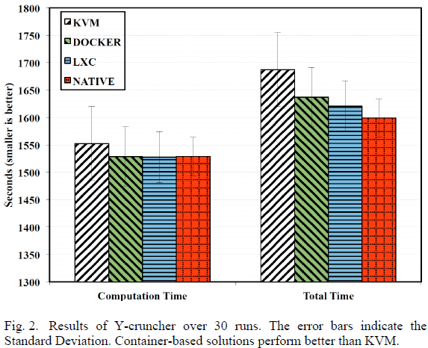
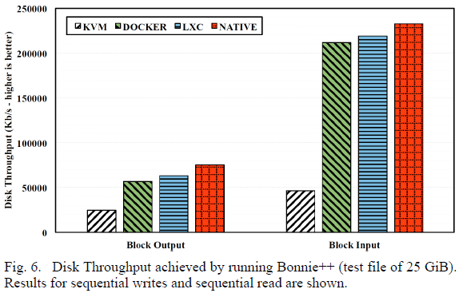
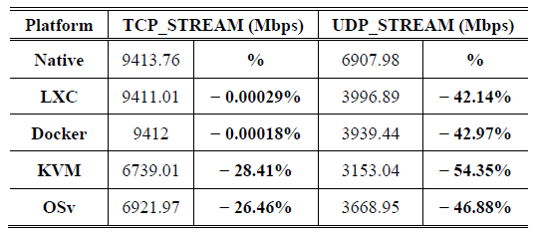
Performance Interference: Causes
Hypervisor or virtual machine monitor (VMM)
has overhead
Virtual CPUs can be de-scheduled without notification and virtual RAM can be swapped out
leads to performance anomalies
KVM Architecture
Figure Source: Morabito, R., Kjällman, J., & Komu, M. (2015, March). Hypervisors vs. lightweight virtualization: a performance comparison. In Cloud Engineering (IC2E), 2015 IEEE International Conference on (pp. 386-393). IEEE..

Slide 16
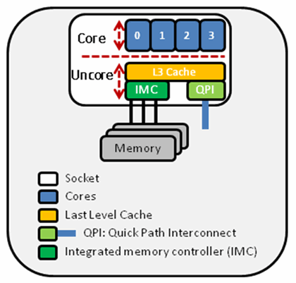
Performance Interference: Causes
Non-Partitionable Hardware Sub Components
Modern Chip Multiprocessors (CMP) architecture contain on-chip resources that cannot be partitioned including:
Last Level Cache
Cache Bandwidth
DRAM Bandwidth
Interconnect networks
Network interfaces and storage disk are also shared across different processes
Notes:
Non-Partitionable Hardware Sub Components
Modern Chip Multiprocessors (CMP) architecture contain on-chip resources that cannot be partitioned including:
Last Level Cache
Cache Bandwidth
DRAM Bandwidth
Interconnect networks
In addition, resources such as network interfaces and storage disk are also shared across different processes
The load imposed on these shared resources by one application is detrimental to all the applications

Slide 17
Key Requirement: Understanding Sources of Interference (SoIs)
Memory capacity
How much memory is consumed
Memory bandwidth
Rate of memory access
Caches
L1 i-cache
L1 instruction cache
L1 d –cache
L1 data Cache
L2 capacity
L2 cache utilization
L2 bandwidth
Defined in: Delimitrou, Christina, and Christos Kozyrakis. "ibench: Quantifying interference for datacenter applications." In Workload Characterization (IISWC), 2013 IEEE International Symposium on, pp. 23-33. IEEE, 2013.

Slide 18
Key Requirement: Understanding Sources of Interference (SoIs)
LLC capacity – Last level cache utilization
LLC bandwidth – Rate of Last level cache utilization
CPU:
Integer Point Unit
Floating Point
Prefetchers
TLBs - Translation lookahead buffer (TLB)
Vector
Interconnection network
Network bandwidth
Storage capacity/bandwidth
Defined in: Delimitrou, Christina, and Christos Kozyrakis. "ibench: Quantifying interference for datacenter applications." In Workload Characterization (IISWC), 2013 IEEE International Symposium on, pp. 23-33. IEEE, 2013.

Slide 19
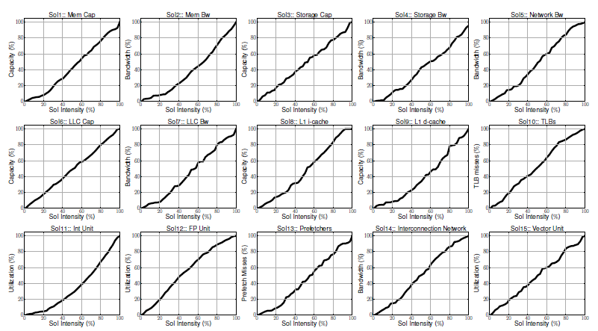
Impact of SoIs
Fig Source: Delimitrou, Christina, and Christos Kozyrakis. "ibench: Quantifying interference for datacenter applications." In Workload Characterization (IISWC), 2013 IEEE International Symposium on, pp. 23-33. IEEE, 2013.

Slide 20

Practical Considerations: Measurement-imposed Challenges
Data Collection
Plethora of deployed hardware configurations
Lack of tools for fine grained performance metrics collection
Lack of Benchmarks
Lack of open source and effective benchmarking
Limitations in existing tooling
Not enough support

Slide 21
Requirements of the Desired Benchmarking/Profiling Framework
Support detailed but configurable metric collection
Be lightweight, scalable and support online collection
Be able to pinpoint sources of interference
Be extensible to accommodate technological advances
Be repeatable and intuitive to the user
Support traceability and maintain a knowledge base of documented patterns of performance interference and resolution approaches

Slide 22
Tutorial Objectives: Recap of the Motivational Arguments & Goals
Recent advances in fog and edge computing have enabled cloud resources to move closer to the CPS/IoT devices
Mitigates network latency concerns to some extent
Several challenges remain in dynamically managing resources across the cloud-edge spectrum
Focus of this tutorial is to provide:
Insights into challenges faced by cloud service providers
Techniques to quantify the issues and application performance
Some solutions to overcome the challenges faced
Hands on

Slide 23
FECBench
Design and Implementation of FECbench

Slide 24
FECBench: An Extensible and Configurable Framework
A framework for benchmarking latency-sensitive applications under various co-located workload patterns across cloud-fog-edge resources
Consists of:
A per server performance monitor
Includes a micro-architectural data collection plugin
A centralized repository
Benchmark applications
Co-located interference applications
Notes:
Tclient: playout delay
which is the time spent by the client to (i) send action information (e.g. initiating character movement in a game) and (ii) receive and play the video. Only the client’s hardware is responsible for tclient
Tserver: the processing delay, which refers to the time spent by the server to process the incoming information from the client, to generate the corresponding video information, and to transmit the information back to the client
Tserver’s processing delay is affected by the amount of computational resources provisioned by the cloud provider
taccess is the data transmission time between the client’s device and the first Internet-connected router. 10 ms to 40 ms
ttransit, which is defined as the delay from the first peering point to the front-end server of the datacenter
tdatacenter is defined as the transmission delay between the front-end server of the datacenter and the hosting server for the client

Slide 25
FECBench: Performance Monitoring Architecture

Slide 26
FECBench: Local Monitoring Agent -- collectd
collectd is a system statistics collection daemon; it uses plugins to collect system statistics and can mangle/publish those statistics in a number of ways.
Platform independent
Extensible via plugins
Most plugins in collectd fall under one of the following categories:
Input plugins: read system statistics at a regular interval, and dispatch the values to the collectd daemon.
Output plugins: receive dispatched values from the daemon and output/write/dispatch those values in various output formats (e.g. JSON, SNMP, AMQP, MySQL, HTTP, etc).
Other plugins:
Binding plugins: provide language bindings to allow plugins to be written in languages other than C.
Logging plugins: which write information to log files or dispatch messages to syslog.
Notification plugins: enable limited monitoring support in collectd.
Other plugins which can both read and dispatch values.

Slide 27
FECBench: Performance Aggregator
Written in Go and Python languages
Reads from AMQP/RabbitMQ message queue
Performance aggregation and persists data in influx DB
Step by Step installation:
https://github.com/doc-vu/indices/blob/master/src/services/collector/README.md
Docker and libvirt plugins:
Plugins are available to collect VM and container metrics
Collectd linux perf plugin supports VM and Docker container micro metrics along with host micro metrics

Slide 28
More Details about Collectd Monitoring Agent

Slide 29
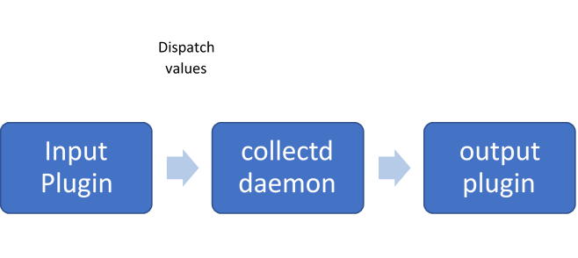
FECBench: Collectd Data Flow

Slide 30
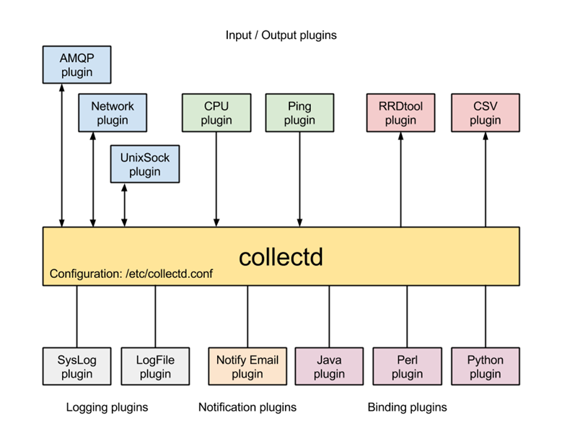
FECBench: Collectd Plugin Architecture

Slide 31
FECBench: Why use collectd?
The collectd API, the selection of available plugins (90+) coupled with the modular nature of collectd architecture, provides a generic path to expose platform statistics from all existing plugins and newly developed plugins to OpenStack or other fault management applications.
collectd also has bindings for several programming languages, which allows a developer to implement a plug-in in their language of choice, without having to modify the receiver of the collected metrics, for example Ceilometer itself.

Slide 32
FECBench: collectd Statistics
Statistics in collectd consist of a value list. A value list includes:
Values
Value length: the number of values in the data set.
Time: timestamp at which the value was collected.
Interval: interval at which to expect a new value.
Host: used to identify the host.
Plugin: used to identify the plugin., eg: CPU
Plugin instance (optional): used to group a set of values together. For e.g. CPU 0,CPU 1
Type: unit used to measure a value. In other words used to refer to a data set.,eg:
Type instance (optional): used to distinguish between values that have an identical type., “user”,”idle”,”system”
meta data: an opaque data structure that enables the passing of additional information about a value list. “Meta data in the global cache can be used to store arbitrary information about an identifier”

Slide 33
FECBench: collectd Values
Values, can be one of:
Gauge: used for values that are stored as is.
Counter: similar to derive values, but take the possibility of a counter wrap around into consideration.
Derive: used for values where a change in the value since it’s last been read is of interest. Can be used to calculate and store a rate.
Absolute: used for counters that are reset after reading

Slide 34
FECBench: Examples of types in collectd
Examples of types in types.db:
bitrate value:GAUGE:0:4294967295
counter value:COUNTER:U:U
if_octets rx:COUNTER:0:4294967295, tx:COUNTER:0:4294967295
In the example above if_octets has two data sources: tx and rx.

Slide 35
FECBench: Filter Configuration
Starting with collectd 4.6 there is a powerful filtering infrastructure implemented in the daemon.
The concept has mostly been copied from ip_tables.
Terminology:
Match: criteria to select specific values.
Target: action that is to be performed with data.
Rule: The combination of any number of matches and at least one target
Chain: a list of rules and possibly default targets. Rules tried in order and if one matches, the associated target will be called.

Slide 36
FECBench: Platform Metrics and Information
Can be divided into static and dynamic information.
Supported metrics by collectd:
https://wiki.opnfv.org/display/fastpath/Collectd+Metrics+and+Events
Next Steps: start defining list of static and dynamic metrics under category sets.

Slide 37
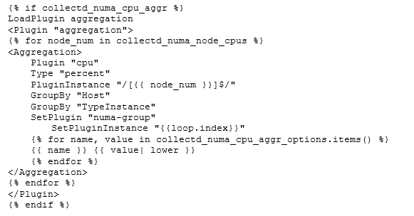
Filter: aggregation

Slide 38
FECBench: Collectd Installation
https://collectd.org/
FECBench needs collectd 5.5 or higher
On Ubuntu:
sudo add-apt-repository ppa:collectd/collectd-5.5
sudo apt-get update
sudo apt-get install collectd -y
Configure collectd:
/etc/collectd/collectd.conf
Step by step documentation:
https://github.com/doc-vu/indices/blob/master/src/services/collector/README.md
We have ansible scripts to perform collectd installation as part of FECBench
https://github.com/doc-vu/Stouts.collectd.git

Slide 39
FECBench: Micro Metrics
System level metrics are not sufficient to identify contention occurring in sub-components
Need metrics that quantify the performance interference
PERF supports hardware events and software events
Hardware events are measured using the hardware performance counters. source of events is the processor itself and its Performance Monitoring Unit (PMU)
Processor implementation specific

Slide 40
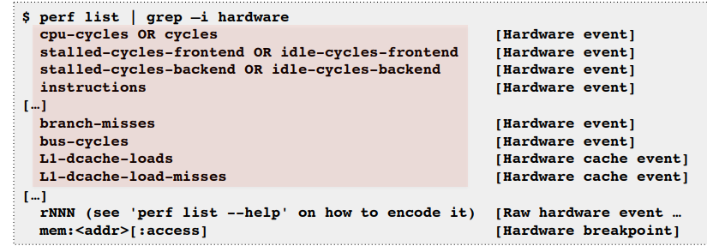
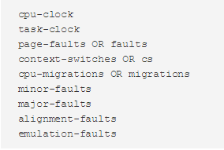
FECBench: Linux Perf
Performance Monitoring Counters (PMCs):
PERF supports several pre-defined software events provided by kernel:

Slide 41
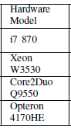
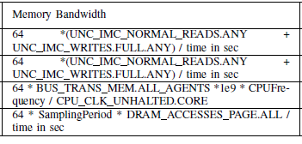
FECBench: Linux Perf
Memory Bandwidth from registers

Slide 42
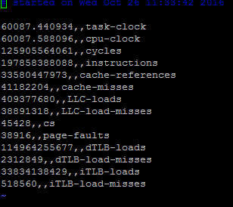
FECBench: Collectd Linux Perf Plugin
Python plugin for collectd
Invokes Linux perf tool
Perf is a profiler tool for Linux 2.6+ systems
Abstracts away CPU hardware differences in Linux performance measurements
Presents a simple commandline interface.
Sample command:
perf stat -x , -e cs,page-faults,cycles,instructions,cache-references,cache-misses,r533fe0,sched:sched_switch,kvm:kvm_exit,sched:sched_stat_wait,sched:sched_stat_iowait -a sleep 5.0
Step by step instructions:
https://github.com/doc-vu/indices/blob/master/perf_monitoring/collectd-linux-perf/README.md

Slide 43
FECBench: Intel Resource Director Technology (Intel RDT)
Cache Monitoring Technology (CMT)
Cache Allocation Technology (CAT)
Memory Bandwidth Monitoring (MBM)
Core
Core
Core
Core
app
Core
Core
app
Core
Core
app
Core
app
app
app
app
app
app
Last
Level
Cache
Last
Level
Cache
Last
Level
Cache
DRAM
Identify misbehaving applications and reschedule according to priority
Cache Occupancy reported on a per Resource Monitoring ID (RMID) basis – Advanced Telemetry
DRAM
Last Level Cache partitioning mechanism enabling separation and prioritization of apps or VMs
Misbehaving threads can be isolated to increase determinism
DRAM
Monitors Memory Bandwidth consumption on per thread/core/app basis
Shares common RMID architecture -- Telemetry
Provides insight into second order of shared resource contention
Source: https://www.intel.com/content/www/us/en/architecture-and-technology/resource-director-technology.html

Slide 44
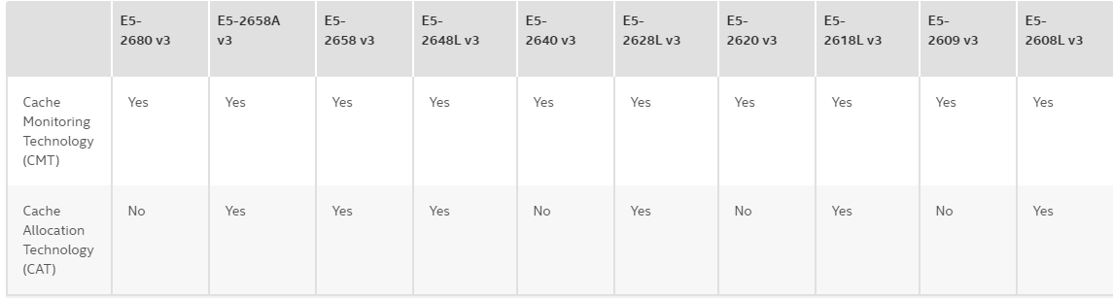
FECBench: Hardware Support
Intel Xeon Processor SKUs that support CMT and CAT
All SKUs starting with the Xeon E5 v4 family

Slide 45
FECBench: Monitoring Data (events)
LLC
Represents LLC Occupancy ( CMT)
MBL
Represents local memory bandwidth (MBM)
MBR
Represents remote memory bandwidth (MBM)
IPC
Represents instructions per cycle (PMU architectural event)
LLC Misses
Represents LLC misses (PMU architectural event)

Slide 46
FECBench: Monitoring (CMT, MBM)
# monitor all cores and all events
-bash-4.3$ sudo pqos
# monitor cores 0 to 11 and all events
-bash-4.3$ sudo pqos –m all:0-11
# monitor LLC occupancy on cores 0, 1, 4 and 6, local memory
bandwidth on cores 8 to 11 and remote memory bandwidth on cores
12-14
-bash-4.3$ sudo pqos –m “llc:0,1,4,6” –m “mbl:8-11” –m “mbr:
12-14”
# reset monitoring infrastructure ; Reclaims in-use RMID's.
-bash-4.3$ sudo pqos -r
Note: Use ctrl-c to stop monitoring

Slide 47
FECBench: Perf CMT and MBM Implementation
• Cache monitoring and Memory Bandwidth monitoring per Pid/tid based
perf list | grep intel_cqm
intel_cqm/llc_occupancy/ [Kernel PMU event]
intel_cqm/local_bytes/ [Kernel PMU event]
intel_cqm/total_bytes/ [Kernel PMU event]
perf stat -e intel_cqm/llc_occupancy/ -e intel_cqm/local_bytes/ -e
intel_cqm/total_bytes/ -p <#pid>

Slide 48
FECBench: Libvirt CMT support
• Libvirt enables CMT event for monitoring VM’s using perf_event_open sys call.
int perf_event_open(struct perf_event_attr *attr, pid_t pid, int cpu, int
group_fd, unsigned long flags)
Libvirt enabling Commands:
• To Enable/Disable CMT perf event for domain:
$virsh perf <domain> --enable <event_name>
For Example: $virsh perf guest01 --enable cmt
• To get the perf events list:
§ $virsh perf <domain>
• To print statistics for the perf events:
§ $ virsh domstats domain

Slide 49
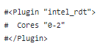
FECBench: Collectd Intel_RDT

Slide 50
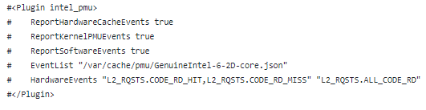
FECBench: Collectd Intel_PMU

Slide 51
FECBench: Benchmarking Applications
https://github.com/doc-vu/indices/tree/master/benchmarks
Image Processing: OpenCV SIFT algorithm (target benchmark)
CloudSuite WebSearch and WebServing (target benchmark)
Parsec (both as target benchmark and interference workload):
parsec.blackscholes, parsec.bodytrack, parsec.dedup
parsec.ferret, parsec.fluidanimate, parsec.freqmine
parsec.swaptions, splash2.barnes, splash2.cholesky
splash2.fft, splash2.fmm, splash2.lu_cb, splash2.lu_ncb
splash2.ocean_cp, splash2.ocean_ncp, splash2.radix
splash2.raytrace, splash2.volrend
splash2x.water_nsquared, splash2x.water_spatial
Phoronix-test-suite (Interference workload)

Slide 52
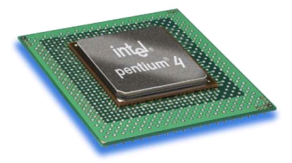






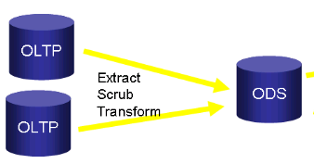


Related Work: State-of-Practice Benchmark Suites
SPEC CPU
SPEC Web
HPCC
PARSEC
TPCC
Gridmix
YCSB
Notes:
Benchmarking is the fundamental of computer science research.

Slide 53
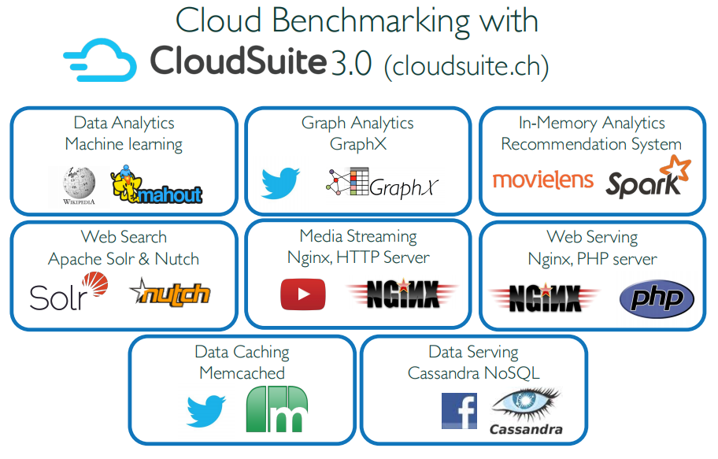
CloudSuite
Source: http://cloudsuite.ch/

Slide 54
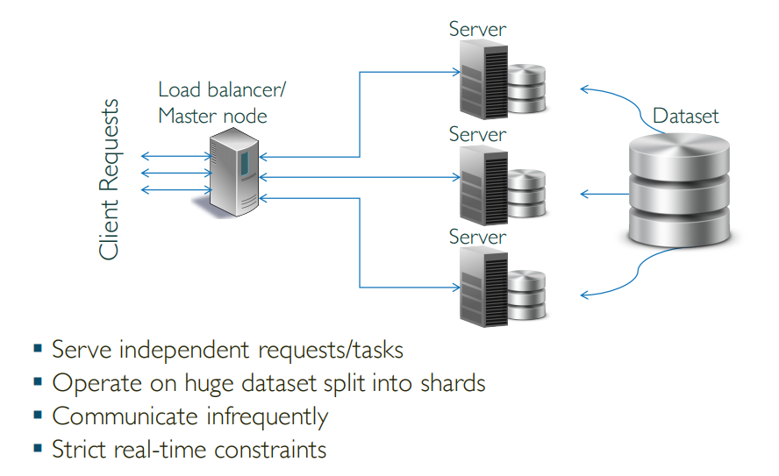
Typical Cloud Workload

Slide 55
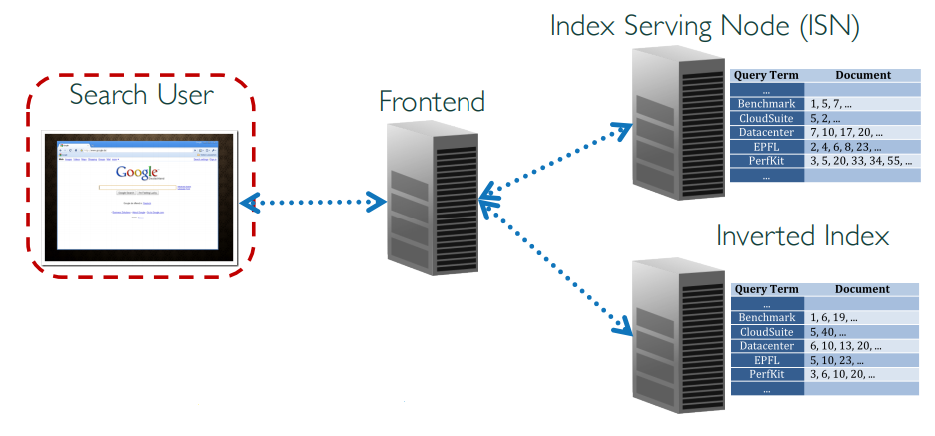
Web Search
Uses Faban traffic generator
Flexible request mixes
# terms per request from published surveys
Terms extracted from the crawled dataset
Apache Solr search engine for ISNs
Performance metrics: search ops/sec, N-th pct latency

Slide 56
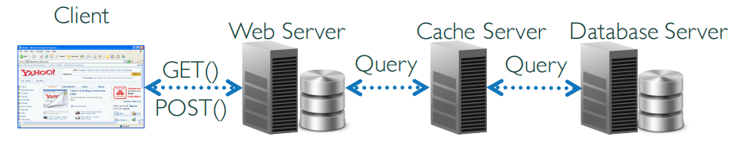
Web Serving
Faban traffic generator
Pre-configured page transition matrix (Elgg)
Web server (Nginx)
Application server (PHP)
Serves a social network engine (Elgg)
Cache server (Memcached)
Database server (MySQL)
Performance metrics
# pages/second served, N-th pct latency

Slide 57
CloudSuite Modifications
CloudSuite does not allow runtime metric collection at remote host
Our modifications to enable this:
https://github.com/doc-vu/faban.git
Container with modifications to cloudsuite websearch:
docker pull shashank/cs-web-search:client

Slide 58
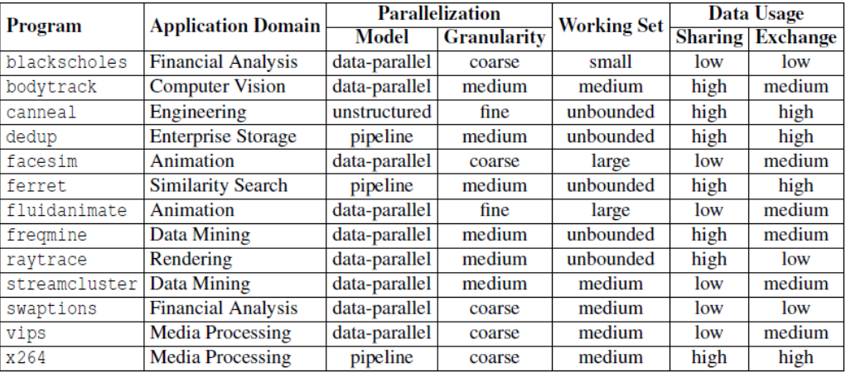
Parsec Benchmark
Benchmark Suite for Chip-Multiprocessors
Source: http://parsec.cs.princeton.edu/download/tutorial/3.0/parsec-tutorial.pdf

Slide 59
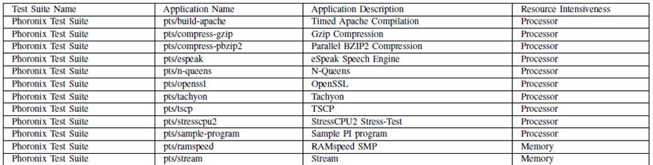
Phoronix Test Suite
Testing & Benchmarking Platform
Cross Platform PHP based solution
Available natively on almost all distributions

Slide 60
FECBench -- DSML
Requirement 1→ Provide higher level interface for configuring and deployment of the FECBench metric collection by abstracting lower level details of programming, deployment platform details.
Requirement 2→ Allow heterogeneity in network topology, node types, test-bed types like native or virtualization infrastructure

Slide 61

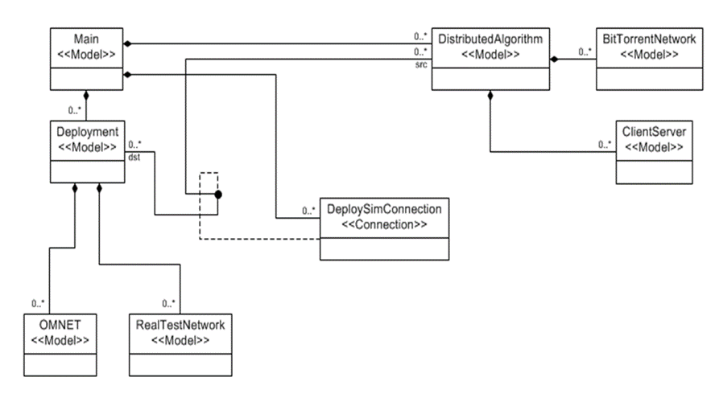
Generic Modeling Environment(WebGME)
Tool developed at Vanderbilt University.
WebGME used to develop the DSML and generative capabilities for PADS provisioning and deployment management of the experiment.
WebGME provides an environment to define the syntax and semantics of a DSML through metamodeling.
Model interpreters can be associated with the metamodels that can provide additional semantics to the language which are not captured in a visual form as well as provide the generative capabilities needed for automation.

Slide 62
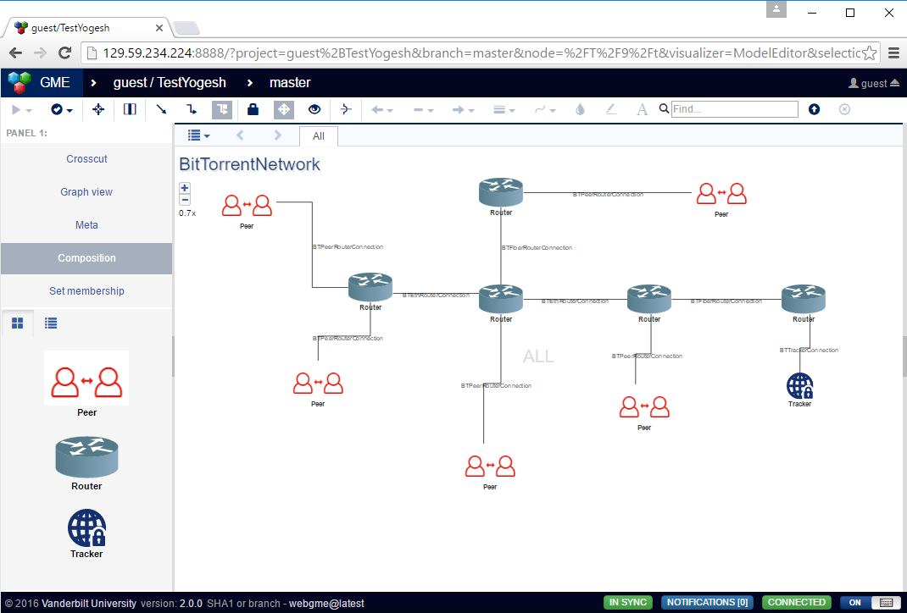
FECBench – WebFrontEnd (In Progress)

Slide 63
iSensitive
CASE STUDY
Faruk Caglar, Shashank Shekhar, Aniruddha Gokhale and Xenofon Koutsoukos. Intelligent, Performance Interference-Aware Resource Management for IoT Cloud Backends. In 2016 IEEE First International Conference on Internet-of-Things Design and Implementation (IoTDI), Berlin, Germany, 2016, pp. 95-105. doi: 10.1109/IoTDI.2015.36

Slide 64
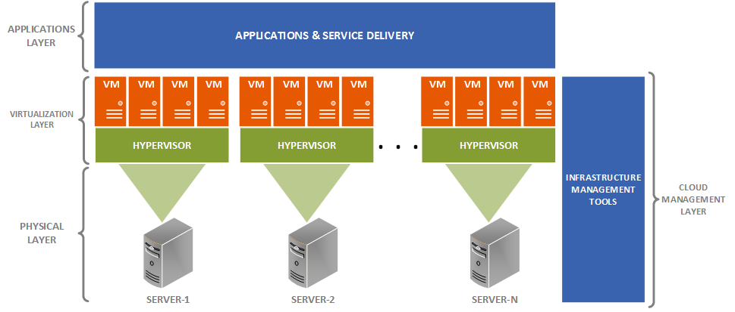
Problem Statement
How to predict the performance interference and its adverse effect that may occur before a VM placement decision is made such that performance interference can be minimized and QoS be maximized?
Notes:
Recall that it is a common practice for CSPs to overbook their physical system resources.
Additionally, Cloud systems are multi-tenant, one application running in one VM may impact the performance of other VMs on the same host machine. This is also called noisy neighbors
Resource overbooking and noisy neighbors can lead to performance interference, anomalies, and faults among the VMs hosted on the physical resources
SO THE CHALLENGE IS HOW TO PREDICT THE PERFORMANCE INTERFERENCE AND THE FAULT THAT MIGHT OCCUR BEFORE A VM IS DEPLOYED AND MAKE VM PLACEMENT BASED ON THIS?

Slide 65
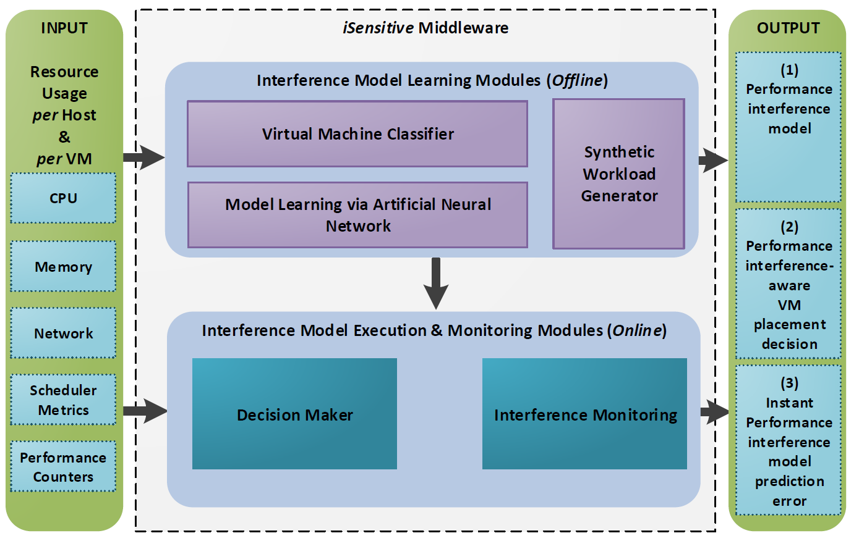
Big Picture: iSensitive System Architecture and Approach
(1) iSensitive utilizes these input parameters – mpstat, perf, and libvirt
(2) Generates training data and validation data along with the VMs.
(3) Clusters VMs into similar sets of objects by employing k-means
(4) Extracts the “best collocated VM patterns” through Feed Forward ANN. Performance interference model is generated.
(5) Finds the aptly-suited host machine having the minimal performance interference level
(6) Compares the actual and predicted performance interference values.
(7) iSensitive’s output.
Notes:
The ultimate goal of the iSensitive is to make a virtual machine placement decisions on to the host machine where performance interference is minimum after migration.
To do that, iSensitive models and predicts the host-level performance interference.
Now let’s break down the architecture and see what each component is responsible for.

Slide 66
Focusing on Offline Phase
Notes:
Now, we are focusing on the offline phase

Slide 67

Detailed System Design and Technical Approach: Synthetic Workload Generator (offline phase)
For machine learning, we
Exploited the VM lifecycle events and their configurations from Google Cluster Trace.
Randomly picked 5 host machines
No knowledge of application types in the Google Cluster Trace
To produce different types of application workloads, we used
Phoronix Test Suite
Netperf, Httperf, Sysbench
Python-based tool
Communicates with cloud manager (OpenNebula)
Instantiates, deploys, starts, and destroys virtual machines
Imitates lifecycles of VMs

Slide 68
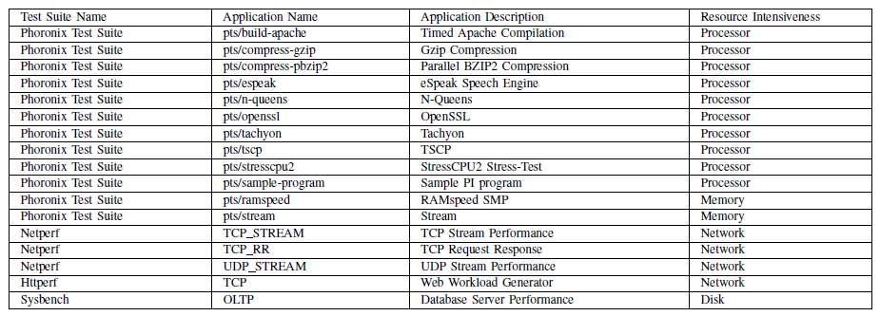
Detailed System Design and Technical Approach: Benchmark Applications Utilized by iSensitive

Slide 69
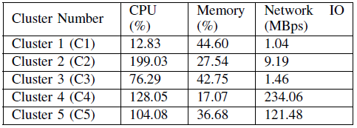
Detailed System Design and Technical Approach: Virtual Machine Classifier(offline phase)
iSensitive monitors resource usage data while the Synthetic Workload generator is running
Logs resource usage data of VMs and Hosts
Clusters VMs based on their CPU, memory, and network usage
Disk-intensive applications are not considered
To decide the best number of clusters
The Silhouette method + K-Means algorithm are employed
Silhouette value for 5 clusters : 0.66 (Max)
The resulting cluster center points is shown in the table below.
Notes:
K-means divides the data set into k clusters randomly and find centroid for each cluster
K-means is simple and computationally faster compared to other clustering algorithms
Silhouette method is used to determine the right number of clusters and measure the quality of the clusters

Slide 70
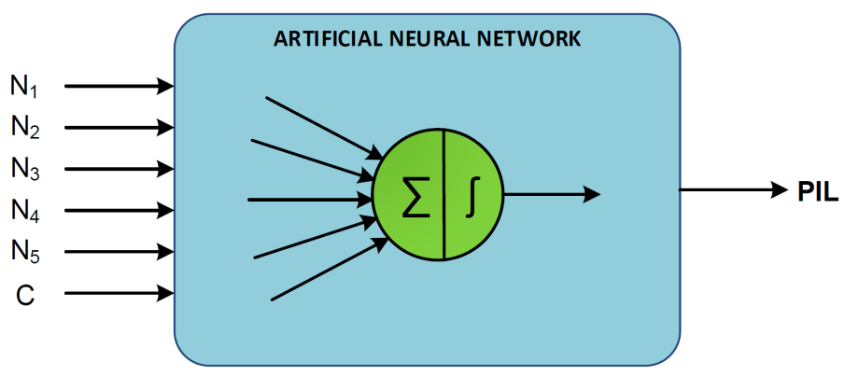
Detailed System Design and Technical Approach: Model Learning via Artificial Neural Network(offline)
Captures the relationship between different types and numbers of VMs of the same cluster and the performance interference.
Discovers the patterns of VM combinations and the resulting degree of performance interference
Back propagation-based ANN
N1 = Total number of VMs of Cluster 1
N2 = Total number of VMs of Cluster 2
N3 = Total number of VMs of Cluster 3
N4 = Total number of VMs of Cluster 4
N5 = Total number of VMs of Cluster 5
C = CPU overbooking ratio
PIL= Performance Interference Level
PIL= Cache Miss Ratio + Scheduler Wait Time % + Scheduler IO Wait Time % + Guest %
Cache Miss Ratio: Ratio of Last-level cache (LLC) misses to total retired instructions.
Scheduler Wait Time %: Waiting time incurred at scheduler’s run queue.
Scheduler IO Wait Time %: Waiting time incurred due to the IO operations.
Guest %: Percentage of CPU time spent by all the virtual CPUs on the host machine.

Slide 71
Focusing on Online Phase

Slide 72

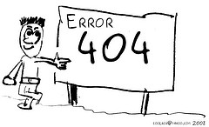
Detailed System Design and Technical Approach: Interference Model Execution and Monitoring(online)
Decision Maker Component
Receives a VM placement request
Iterates over all of the host machines
Executes trained ANN and predicts PIL on each host
Places VM on host with the lowest performance interference level
Interference Monitoring Component
Keeps track of error rate at run-time between actual and predicted PIL.
Different workload patterns that were not known by the trained model might happen & cause high prediction errors.
Responsibilities: (used for model updating &incremental learning)
If prediction error > configured threshold value
Log actual workload pattern for re-training
If VM is way off from the actual cluster center points
Log actual VM resource utilization for re-clustering

Slide 73
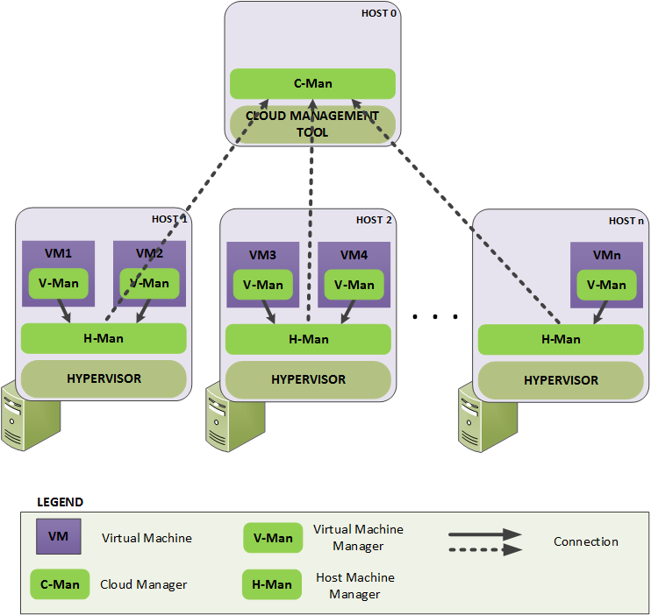
iSensitive Implementation Distributed System Middleware Architecture
Virtual Machine Manager (V-Man)
Collects resource usage in the VM (Memory utilization)
Statistics which are only known by the VM’s guest OS kernel
Posts to H-Man
Host Manager (H-Man)
Accumulates statistics received from V-Man(s) and physical host machine
Posts to C-Man
Handles instant resource usage spikes
Cloud Manager (C-Man)
Decision maker
Captures overall view of cloud

Slide 74
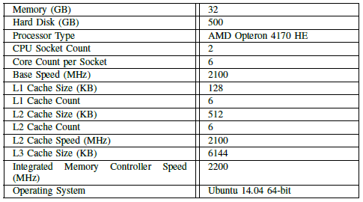
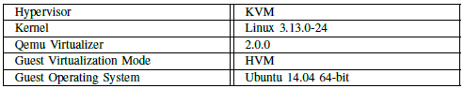
Validating the iSensitive Approach: Experimental Setup
Hardware and Software Specification of the Experiment Host
Virtualization Specification of the Experiment Host

Slide 75
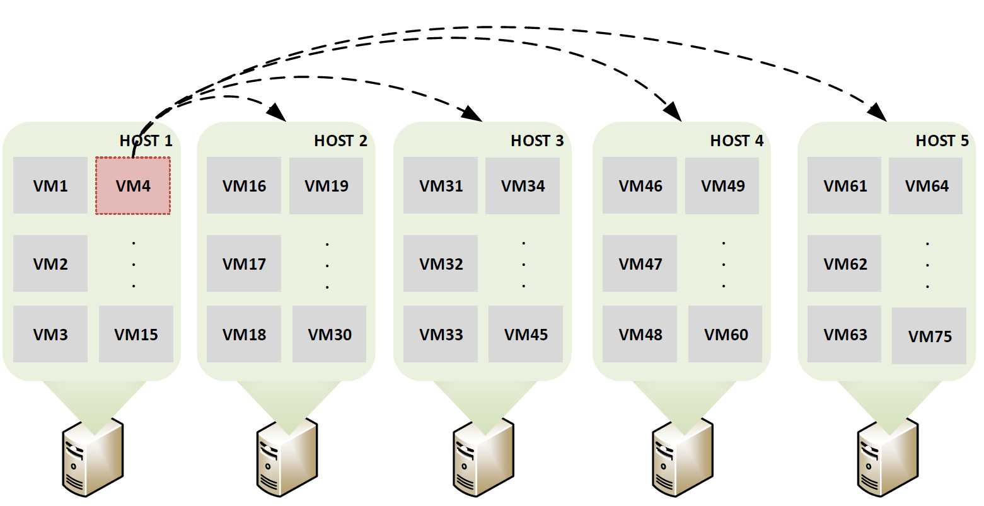
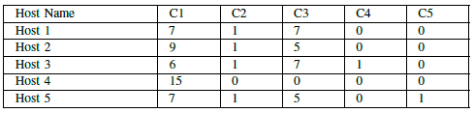
Validating the iSensitive Approach: Experimental Setup
Created 15 VMs on 5 host machines (5 per host)
Each VM has 2 vCPUs and 512MB of Memory
CPU Overbooking ratio for each host machine is 2.5
Workload on VMs is randomly chosen from the benchmarking applications
Number of VMs in each cluster for each host machine is illustrated as in the table.
Procedure: Experiments were conducted by selecting one of the VMs (VM4) from Cluster 3 on Host 1 and requesting a migration decision from iSensitive, and comparing it with first-fit bin packing heuristic.

Slide 76
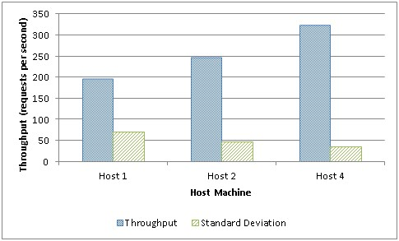
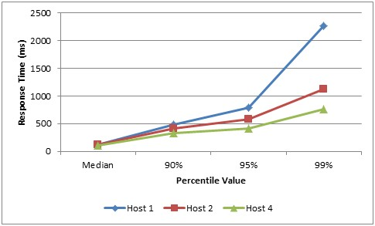

Validating the iSensitive Approach: Application Performance Improvement
Apache Web Server’s Performance Results
Host 1: Before Migration
Host 2: First-fit heuristic, Host 4: iSensitive
First-fit : 25% Throughput Improvement
iSensitive : 64% Throughput Improvement
Overhead : ~1% V-Man & C-Man and ~5% H-Man
15 V-Man to the 1 H-Man with 1 sec interval
5 H-Man to the 1 C-Man with 15 sec interval
(a) Throughput on Host 1, 2, and 4
(b) Response time percentiles on Host 1, 2, and 4
(c) Response time over time on Host 1, 2, and 4

Slide 77
Lessons Learned
Clustering-based VM placement middleware utilizing artificial neural network helps to capture best VM collocation patterns and find aptly-suited host machine for VM migration decisions.
Hardware-level performance statistics can be analyzed in deep and performance-interference model can be enhanced with additional parameters.

Slide 78
INDICES (INtelligent Deployer for ubIquitous Cloud and Edge Services)
CASE STUDY
Shashank Shekhar, Ajay Chhokra, Anirban Bhattacharjee, Guillaume Aupy, and Aniruddha Gokhale. "INDICES: Exploiting Edge Resources for Performance-aware Cloud-hosted Services." In 1st IEEE International Conference on Fog and Edge Computing (ICFEC), Madrid, Spain. 2017.

Slide 79

Resource Management across Cloud-Fog-Edge Resources with Performance Interference Focus
Cloud is an attractive hosting platform for a variety of latency-critical applications
End-to-end latency for cloud-hosted applications is computed as:
Can be reduced by fog and edge computing
However, latencies exceeding 100 milliseconds result in unacceptable user experience for interactive applications
For geographically distributed users, latencies may be on the order of several hundreds of milliseconds
Our research has designed the algorithms and systems software to make runtime decisions on exploiting the fog/edge resources for cloud-hosted latency-sensitive applications
Notes:
Tclient: playout delay
which is the time spent by the client to (i) send action information (e.g. initiating character movement in a game) and (ii) receive and play the video. Only the client’s hardware is responsible for tclient
Tserver: the processing delay, which refers to the time spent by the server to process the incoming information from the client, to generate the corresponding video information, and to transmit the information back to the client
Tserver’s processing delay is affected by the amount of computational resources provisioned by the cloud provider
taccess is the data transmission time between the client’s device and the first Internet-connected router. 10 ms to 40 ms
ttransit, which is defined as the delay from the first peering point to the front-end server of the datacenter
tdatacenter is defined as the transmission delay between the front-end server of the datacenter and the hosting server for the client

Slide 80
Emerging Cloud-Fog-Edge Computing Architectures

Slide 81
Key Challenges in Cloud-Edge Resource Management (1/5)
Multiple edge/ fog resources available
Multiple edge/ fog resources available
Multiple edge/ fog resources available
Multiple edge/ fog resources available

Slide 82
Key Challenges in Cloud-Edge Resource Management (2/5)
Different network latencies
Multiple edge/ fog resources available
Multiple edge/ fog resources available
Multiple edge/ fog resources available

Slide 83
Key Challenges in Cloud-Edge Resource Management (3/5)
Multiple edge/ fog resources available
Multiple edge/ fog resources available
Hardware Heterogeneity
Multiple edge/ fog resources available

Slide 84

Key Challenges in Cloud-Edge Resource Management (4/5)
Co-located applications

Slide 85
Key Challenges in Cloud-Edge Resource Management (5/5)
Different network latencies
Hardware Heterogeneity
Co-located applications
Which fog/edge resource to choose?

Slide 86



Required Functionalities
State Transfer
System Performance Monitoring
Execution Time Estimation
System Performance Monitoring
Network Latency Estimation

Slide 87

INDICES Architecture
Two level hierarchy reduces the amount of data transfer and thus the system overhead

Slide 88
Performance Monitor
Consists of a data collector developed using collectd monitoring framework
Resides on each physical host in the system
Connects and logs metrics at the local manager lm_{m} using AMQP protocol
Required to predict eet

Slide 89
Performance Monitor
Consists of a data collector developed using collectd monitoring framework
Resides on each physical host in the system
Connects and logs metrics at the local manager lm_{m} using AMQP protocol
Required to predict eet
Collected Metrics:
System Metrics: CPU utilization, memory utilization, network I/O, disk I/O, context switches, page faults
Hardware Counters: Retired instructions per second (IPS), cache utilization, cache misses, last-level cache bandwidth and mem bandwidth
Developed Linux perf plugin for collectd to achieve this
Bandwidth counters not directly available, derived based on literature
Hypervisor metrics: Scheduler wait time, Scheduler I/O wait time, scheduler VM exits
In addition, application virtual machine reports the per step execution time

Slide 90
Performance Predictor – Interference Profile
Execution time eet varies due to:
Hardware heterogeneity
Performance interference from co-located applications
Interference Profile of an application consists:
Sensitivity: Performance degradation of an application due to interference from other applications
Pressure: Performance degradation of other co-located applications on the host due to the application

Slide 91


Performance Predictor – Interference Profile
Sensitivity due to performance interference can be defined as:
X_{w} are the current measured metrics on hardware configuration w
To measure the pressure, we take an indirect approach, wherein we first estimate the new metrics on the host:
Later we use these metrics to estimate the pressure on existing applications, J_{h}

Slide 92
Performance Predictor – Offline Phase
Offline phase occurs at the CDC and involves benchmarking and training
Un-profiled applications are benchmarked on different host configurations with co-located applications of different types
Number of profiling configurations can be huge
Select a subset of from a uniformly distributed co-location combinations
Apply standard supervised machine learning techniques to develop sensitivity and pressure profiles
Feature Selection:
Applied Recursive Feature Elimination (RFE) using Gradient Boosted Regression Trees
Selects the optimal set of features and reduces training time
Correlation Analysis:
Used Pearson Coefficient to eliminate highly dependent metrics with a threshold of ± 0.8
Further reduces the training time by decreasing the dimensions of the feature vector
Regression Analysis:
Gradient Tree Boosting Curve Fitting method
Notes:
handle heterogeneous features and its robustness
to outliers
Feature selection: shorter training times, enhanced generalization by reducing overfitting

Slide 93
Performance Predictor – Online Phase
The learned models are exported and forwarded to the MDC local manager for the available hardware platforms in the MDC
Each MDC is small in size and typically illustrates limited heterogeneity in the supported hardware
The number of estimation models is expected to be small for each application
On receiving a request from the global manager gm, the local manager lm_{m} estimates the performance of an application
Uses the logged data to feed to the estimator
The sensitivity and pressure are calculated as described earlier

Slide 94
Network Latency Estimation
On each client, instrumented “app” is installed
periodically reports the observed response time
Used to determine the clients who suffer SLO violations
When the gm observes SLO violations, it identifies the nearby MDCs close to the clients using their IP address
To measure the latency from the client, each lm_{m} runs TCP and HTTP servers

Slide 95
Network Latency Estimation
The max latency client then posts n requests to each lm_{m} with a file that it typically posts to the cloud for processing
n should be small for faster decision
The file size is not expected to vary a lot e.g. for image processing with same camera resolution
Workload does not have large variations

Slide 96

State Transfer
Several solutions available for WAN-scale virtual machine migration
e.g. Openstack++ and cloudlet
We leverage the cloud virtual disk format: qcow2
VM disk is composed of a base image and can contain several overlays on top of it for change sets
Base image is assumed to be present on MDC hosts to save on migration costs
can be shared by multiple VMs
VM overlay when combined with the base image constructs the VM
Overlays are created using external snapshots
It the state that gets transferred to h_{m}
Once the application starts running, it informs the gm and all the application clients are redirected to the new application URL

Slide 97

Server Selection Algorithm
Identify SLO violations
Identify nearby MDCs
Estimate transfer cost
Measure network latency
Estimate sensitivity and pressure
Estimate execution time
Find minimum cost if constraints satisfied

Slide 98



Experimental Setup

Slide 99
Application Use Case
Our use case is an image processing application that performs feature detection
e.g., facial recognition in computer vision
We use the well-known Scale Invariant Feature Transform (SIFT) to find the scale and rotation independent features
Client-side interface of the application continuously streams frames
fixed rate of 5 frames per second
video resolution is 640x360 pixels
average frame size is 56 KB
Server comprises a Python-based application that receives frames over a TCP socket, processes it, and responds with the identified features
Client expects to receive a response before sending the next frame, implying that 200 ms is the deadline for the application, SLO was set to 95%.
For hardware platforms A,B,C,D the base execution times, eet_{a}, were measured to be 86, 91, 146, 157 ms respectively.

Slide 100

Evaluating the Performance Estimation Model

Slide 101


Evaluating the Server Selection Algorithm: INDICES vs Least loaded

Slide 102


Evaluating the Server Selection Algorithm: INDICES vs Minimum Hop

Slide 103

Evaluating Usage of Overlay Files
Notes:
10 Mbps, 1 MBps
938 MB has to transferred over 10 Mbps bandwidth
We observe that the server selection takes 1 sec,
however, the migration and initialization takes 32s, 56s and
190s respectively for a, b and c scenarios

Slide 104
Lessons Learned
This work presented an approach for dynamic cloud resource management that exploits the available edge/fog resources in the form of micro data centers
Our algorithm ensures that existing edge-deployed services are not unduly impacted
Deployment costs for the cloud provider are minimized
The objectives are met using an online optimization problem
Solved using a two-level cooperative and online setup
Our experimental results support our claims
Going forward, we need to address workload variability and mobility related challenges

Slide 105
Vertical elasticity
CASE STUDY
Submitted: Shashank Shekhar, Hamzah Abdel-Aziz, Anirban Bhattacharjee, Aniruddha Gokhale and Xenofon Koutsoukos. "Performance-Aware Vertical Elasticity for
Latency-Sensitive Applications." Submitted to 18th IEEE/ACM International Symposium on Cluster, Cloud and Grid Computing, 2018

Slide 106
Performance-Aware Vertical Elasticity for Latency-Sensitive Applications
Vertical elasticity for dynamic scaling of applications
Hardware advancements
Rack-scale computing
Ability to dynamically resize applications residing in containers or virtual machines
Fine-grained assignment of resources
Applications demonstrate dynamic workload profiles
Performance interference between the co-located applications significantly affects QoS properties of applications
Leads to violation of their service level objectives (SLOs)

Slide 107
Performance-Aware Vertical Elasticity for Latency-Sensitive Applications
Latency sensitive applications assigned dedicated cores
CPU core pinning
Increases cache utilization and reducing processor switches
Performance interference still manifests
particularly severe in the case of tail latency
Reactive approaches need very high rate of performance metric collection to react quickly to workload variations
Relies on checkpointing and migration
takes long durations
Solution: Proactively forecast the workload to perform vertical scaling while accounting for interference imposed by co-located workloads
Assign additional resources proactively
Extra cores also alleviate performance interference

Slide 108

Solution - Learning

Slide 109

Solution Prediction

Slide 110

Architecture

Slide 111

Validation

Slide 112
Lessons Learned
Current work lacks finer-grained resource control
Managing CPU shares
Memory, last-level cache and network allocation
We are exploring the use of modern hardware advances
Intel’s cache allocation technology (CAT)
Software-defined networking approaches to control network resource allocations
Consider combining vertical scaling with horizontal scaling
Include different categories of workloads, which can be both predictable and unpredictable
Apply distributed machine learning

Slide 113
Future Directions for FECBench
In the context of a joint cloud-fog-edge resource management scenario, we need a decentralized and distributed FECBench architecture
Be able to collect various metrics across heterogeneous range of devices
Decentralized yet coordinated resource management decisions
System will need to deal with CAP theorem issues

Slide 114
Final thoughts
Wrapup

Slide 115
Concluding Remarks
Performance interference is a key systems issue that adversely impacts application performance but often receives less attention
Interference cannot be avoided since providers will always try to pack applications in as less a number of resources as possible
Need to have fine-grained and configurable but lightweight and scalable metrics collection capabilities
This tutorial presented the design of and hands-on activities on the FECBench framework
Future work is extending these capabilities to cover the cloud-fog-edge spectrum

Slide 116
Feedback Needed
Please provide us feedback on the tutorial itself
On new features you would like to see
Missing capabilities and/or additional systems metrics we need to include
Operational contexts that may differ from what we are looking at

Slide 117
Q/A & Thank You!
Sources:
https://github.com/doc-vu/indices.git
More to come!
Contacts:
Shashank Shekhar – shashank.shekhar@Vanderbilt.edu
Yogesh Barve – Yogesh.d.barve@Vanderbilt.edu
Aniruddha Gokhale – a.Gokhale@Vanderbilt.edu

Slide 118
Emerging Trends: Performance Interference at Multiple Levels
Cloud is an attractive hosting platform for a variety of latency-critical applications
End-to-end latency for cloud-hosted applications is computed as:
How can the cloud provider manage the latencies for cloud-hosted latency-sensitive applications?
However, latencies exceeding 100 milliseconds result in unacceptable user experience for interactive applications
For geographically distributed users, latencies may be on the order of several hundreds of milliseconds
Notes:
Tclient: playout delay
which is the time spent by the client to (i) send action information (e.g. initiating character movement in a game) and (ii) receive and play the video. Only the client’s hardware is responsible for tclient
Tserver: the processing delay, which refers to the time spent by the server to process the incoming information from the client, to generate the corresponding video information, and to transmit the information back to the client
Tserver’s processing delay is affected by the amount of computational resources provisioned by the cloud provider
taccess is the data transmission time between the client’s device and the first Internet-connected router. 10 ms to 40 ms
ttransit, which is defined as the delay from the first peering point to the front-end server of the datacenter
tdatacenter is defined as the transmission delay between the front-end server of the datacenter and the hosting server for the client

Slide 119
Emerging Trends: Performance Interference at Multiple Levels
Cloud is an attractive hosting platform for a variety of latency-critical applications
End-to-end latency for cloud-hosted applications is computed as:
Typically < 1 ms => not an issue
Cannot be managed by Cloud Provider
Cannot be managed by Cloud Provider
However, latencies exceeding 100 milliseconds result in unacceptable user experience for interactive applications
For geographically distributed users, latencies may be on the order of several hundreds of milliseconds
Notes:
Tclient: playout delay
which is the time spent by the client to (i) send action information (e.g. initiating character movement in a game) and (ii) receive and play the video. Only the client’s hardware is responsible for tclient
Tserver: the processing delay, which refers to the time spent by the server to process the incoming information from the client, to generate the corresponding video information, and to transmit the information back to the client
Tserver’s processing delay is affected by the amount of computational resources provisioned by the cloud provider
taccess is the data transmission time between the client’s device and the first Internet-connected router. 10 ms to 40 ms
ttransit, which is defined as the delay from the first peering point to the front-end server of the datacenter
tdatacenter is defined as the transmission delay between the front-end server of the datacenter and the hosting server for the client

Slide 120
Emerging Trends: Performance Interference at Multiple Levels
Cloud is an attractive hosting platform for a variety of latency-critical applications
End-to-end latency for cloud-hosted applications is computed as:
Can be managed by cloud providers
Can be managed by service providers
However, latencies exceeding 100 milliseconds result in unacceptable user experience for interactive applications
For geographically distributed users, latencies may be on the order of several hundreds of milliseconds
Notes:
Tclient: playout delay
which is the time spent by the client to (i) send action information (e.g. initiating character movement in a game) and (ii) receive and play the video. Only the client’s hardware is responsible for tclient
Tserver: the processing delay, which refers to the time spent by the server to process the incoming information from the client, to generate the corresponding video information, and to transmit the information back to the client
Tserver’s processing delay is affected by the amount of computational resources provisioned by the cloud provider
taccess is the data transmission time between the client’s device and the first Internet-connected router. 10 ms to 40 ms
ttransit, which is defined as the delay from the first peering point to the front-end server of the datacenter
tdatacenter is defined as the transmission delay between the front-end server of the datacenter and the hosting server for the client

Slide 121
Emerging Trends: Performance Interference at Multiple Levels
Cloud is an attractive hosting platform for a variety of latency-critical applications
End-to-end latency for cloud-hosted applications is computed as:
Can be reduced by fog and edge computing
However, latencies exceeding 100 milliseconds result in unacceptable user experience for interactive applications
For geographically distributed users, latencies may be on the order of several hundreds of milliseconds
It becomes critical to understand sources of performance interference at multiple levels: cloud-fog-edge
Notes:
Tclient: playout delay
which is the time spent by the client to (i) send action information (e.g. initiating character movement in a game) and (ii) receive and play the video. Only the client’s hardware is responsible for tclient
Tserver: the processing delay, which refers to the time spent by the server to process the incoming information from the client, to generate the corresponding video information, and to transmit the information back to the client
Tserver’s processing delay is affected by the amount of computational resources provisioned by the cloud provider
taccess is the data transmission time between the client’s device and the first Internet-connected router. 10 ms to 40 ms
ttransit, which is defined as the delay from the first peering point to the front-end server of the datacenter
tdatacenter is defined as the transmission delay between the front-end server of the datacenter and the hosting server for the client

Slide 122


Need: Supporting INDICES and Similar Emerging Ideas
Centralized data center (CDC) is connected to a group of micro data centers (MDCs):
MDCs are assumed to be owned or leased exclusively by the CDC
Each MDC, comprises a set of
compute servers, H_{m}
Responsible for:
data collection
performance estimation
latency measurements
MDC-level decision making
Responsible for detecting and mitigating SLO violations

Slide 123



Application Model (1/2)
Consider a set Apps of latency-sensitive applications
Each application is initially deployed in CDC in a VM
Application has a single user or a small number of users, U_{a}
Users are located in similar network latency region
Application a is streaming or interactive in nature consisting of multiple steps
A subset PA from the set of applications Apps are identified by the system as suffering from performance degradation

Slide 124


Application Model (2/2)
For each , Φ_{a} denote the acceptable response time for each step
Execution time per step
η
Network
latency
The service level objective (SLO) for the application is defined as:
Notes:
Consider a set Apps of latency-sensitive applications.
Each application a 2 Apps is initially deployed in CDC with U_{a} number of users in a VM
Users are located in similar network latency region
Application a is streaming or interactive in nature consisting of multiple steps
The service level objective (SLO) for the application is defined as:
is the estimated execution time of a step of application a on host , where is the set of all active hosts
For each user , represents the estimated round-trip network latency
the application-defined bounds on acceptable response time for each interactive step of the application
A subset PA from the set of applications Apps are identified by the system as suffering from performance degradation

Slide 125



State Transfer Model (1/2)
To meet SLO, each application has to be migrated to a MDC host
The transfer cost associated with state transfer of p from CDC to h is:
s_{p}
state size
b_{m}
backhaul network bandwidth
h

Slide 126
State Transfer Model (1/2)
To meet SLO, each application has to be migrated to a MDC host
The transfer cost associated with state transfer of p from CDC to h is:
s_{p}
state size
b_{m}
backhaul network bandwidth
ci_{p,h}
Initialization cost
h

Slide 127

State Transfer Model (2/2)
dd
eed_{p} is the expected remaining execution duration of application p
tolerance percentage value before the application user starts to observe the improved response time
h

Slide 128


Service Provider Costs
For the service provider, the cost of deploying an application on MDC server is much higher compared CDC server
for deploying applications p on host h, cost is the extra duration for which the server has to be turned on and can be represented as:
J_{h} represent the set of all applications currently running on a MDC host h and
The total cost for deployment on host h is:
Constant D depends on cost of powering on the MDC
server h, and depends on the cost for transferring
the state to host h
h
J_{h}
existing apps
p
target app

Slide 129




Objective Formulation
Optimization problem:
existing apps
target app
transfer duration

Slide 130
Solution: INDICES (INtelligent Deployer for ubIquitous Cloud and Edge Services)
Different network latencies
Hardware Heterogeneity
Co-located applications
Which edge resource to choose?

